Slide 1



Design of a Pipelined ANN Processing Element for RISC-V Core
By Irfa Farooq
Khansa Mishqat
Haseeb Umer

Slide 2
Table Of Content
01
02
03
04
05
Introduction
Problem Statement
Solution
System’s Model
Mathematical Model of ANN
06
07
08
Architecture
Custom Instruction
Results & Conclusion

Slide 3

INTRODUCTION
Embedded devices are now expected to support machine learning inference.
Neural networks are dominated by MAC operations
RISC-V cores are flexible but inefficient for ANN inference
Software-only execution causes high latency and energy cost
Hardware acceleration via a dedicated ANN Processing Element (PE)
Integration of PE into RV32 core enables faster and efficient ANN execution

Slide 4
PROBLEM STATEMENT
ANN inference requires multiply–accumulate operations
RV32 executes MACs using multiple instructions
which Results in:
High execution latency
Increased energy consumption
Inefficient use of processor resources
Floating-point support is expensive in hardware

Slide 5

PROPOSED SOLUTION
Integrate a dedicated ANN Processing Element (PE) into RV32 core
PE accelerates:
Fixed-point MAC operations
ReLU activation
Pipelined architecture for higher throughput
Integrate a dedicated ANN Processing Element (PE) into RV32 core

Slide 6
systeM’s Model
ANN Processing Element (PE)
Fixed-point pipelined neuron implementation
MAC, ReLU, and Quantization in hardware
Designed for efficient ANN inference
Integration into RV32 Core
PE tightly coupled with RV32 processor
Accelerates compute-intensive ANN operations
Reduces software instruction overhead
Software-Based Functional Verification
C reference implementation of ANN
Assembly-level implementation for low-level validation
Hardware results compared against software outputs

Slide 7
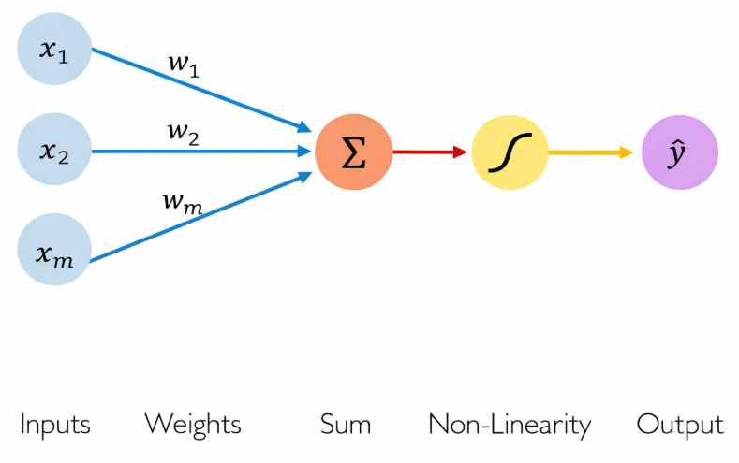
MATHEMATICAL MODEL OF ANN

Slide 8
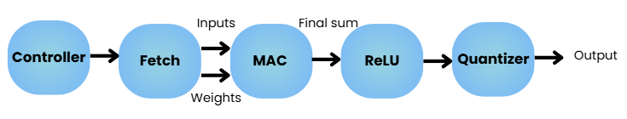
DATA FLOW

Slide 9
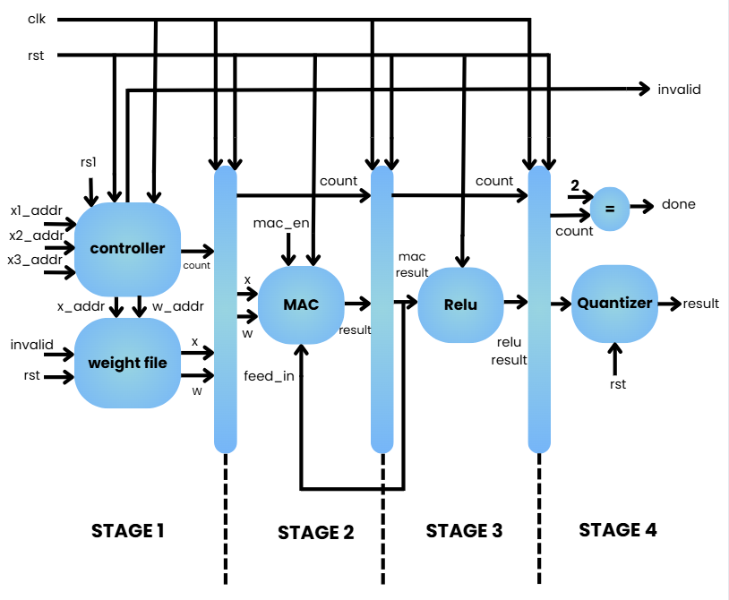
ANN’s Architecture

Slide 10
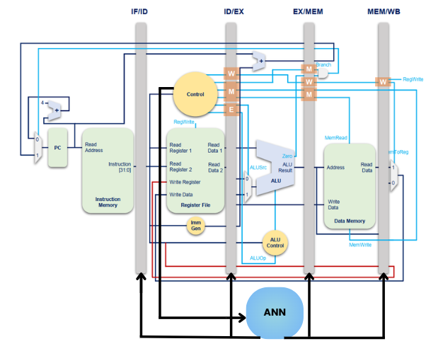
Core’s Architecture

Slide 11
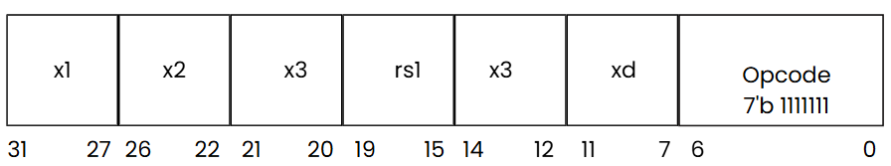
CUstom instruction

Slide 12

Design & Verification
Simulation-based verification using test vectors loaded from memory files
Cycle-accurate comparison between hardware outputs and reference results
Software reference model implemented in C for functional validation
ReLU activation verified, ensuring correct clipping of negative sums

Slide 13
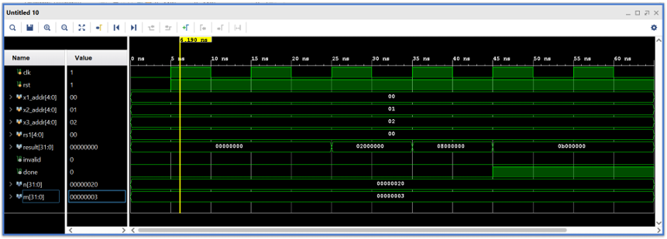
RESULTS
Simulation Waveforms

Slide 14
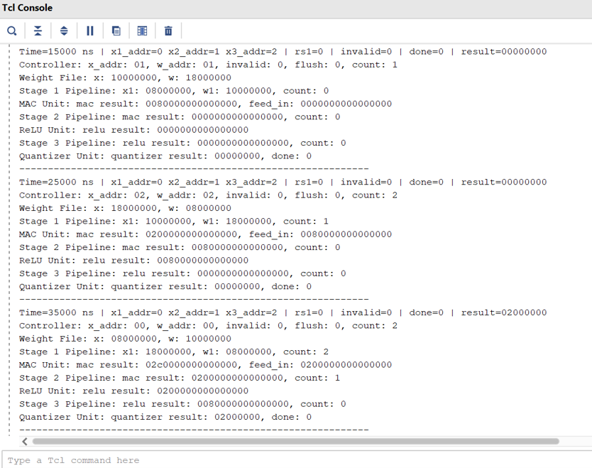
Tcl Console’s Output

Slide 15
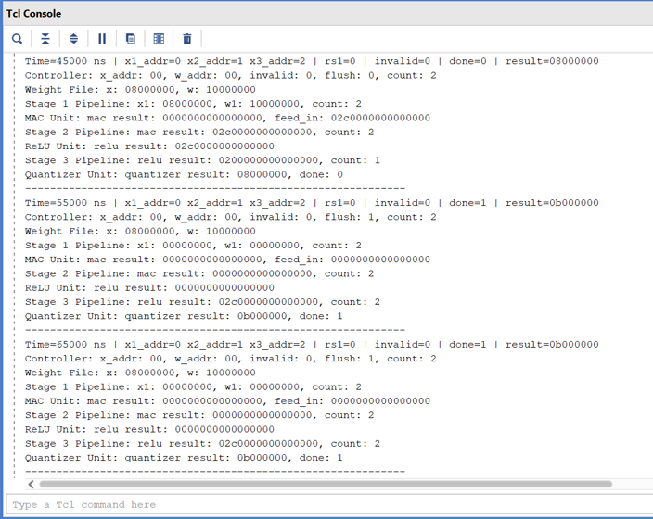
Tcl Console’s Output

Slide 16
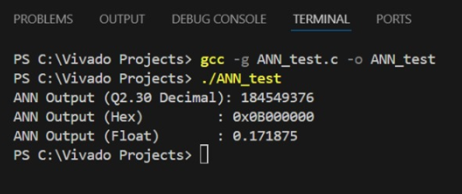
RESULTS
C Code Output

Slide 17

RESULTS
Assembly Code Output

Slide 18
CONCLUSION
Designed and verified a simple, pipelined neural network processing element in Verilog HDL
Demonstrated efficient mapping of neuron computation to hardware using a single MAC unit
Verified functional correctness using a software reference model and simulation
Showed how pipelining improves throughput compared to sequential computation
Established a clear foundation for extending the design to multiple neurons or layers

Slide 19

THANK YOU!

